Slide 1
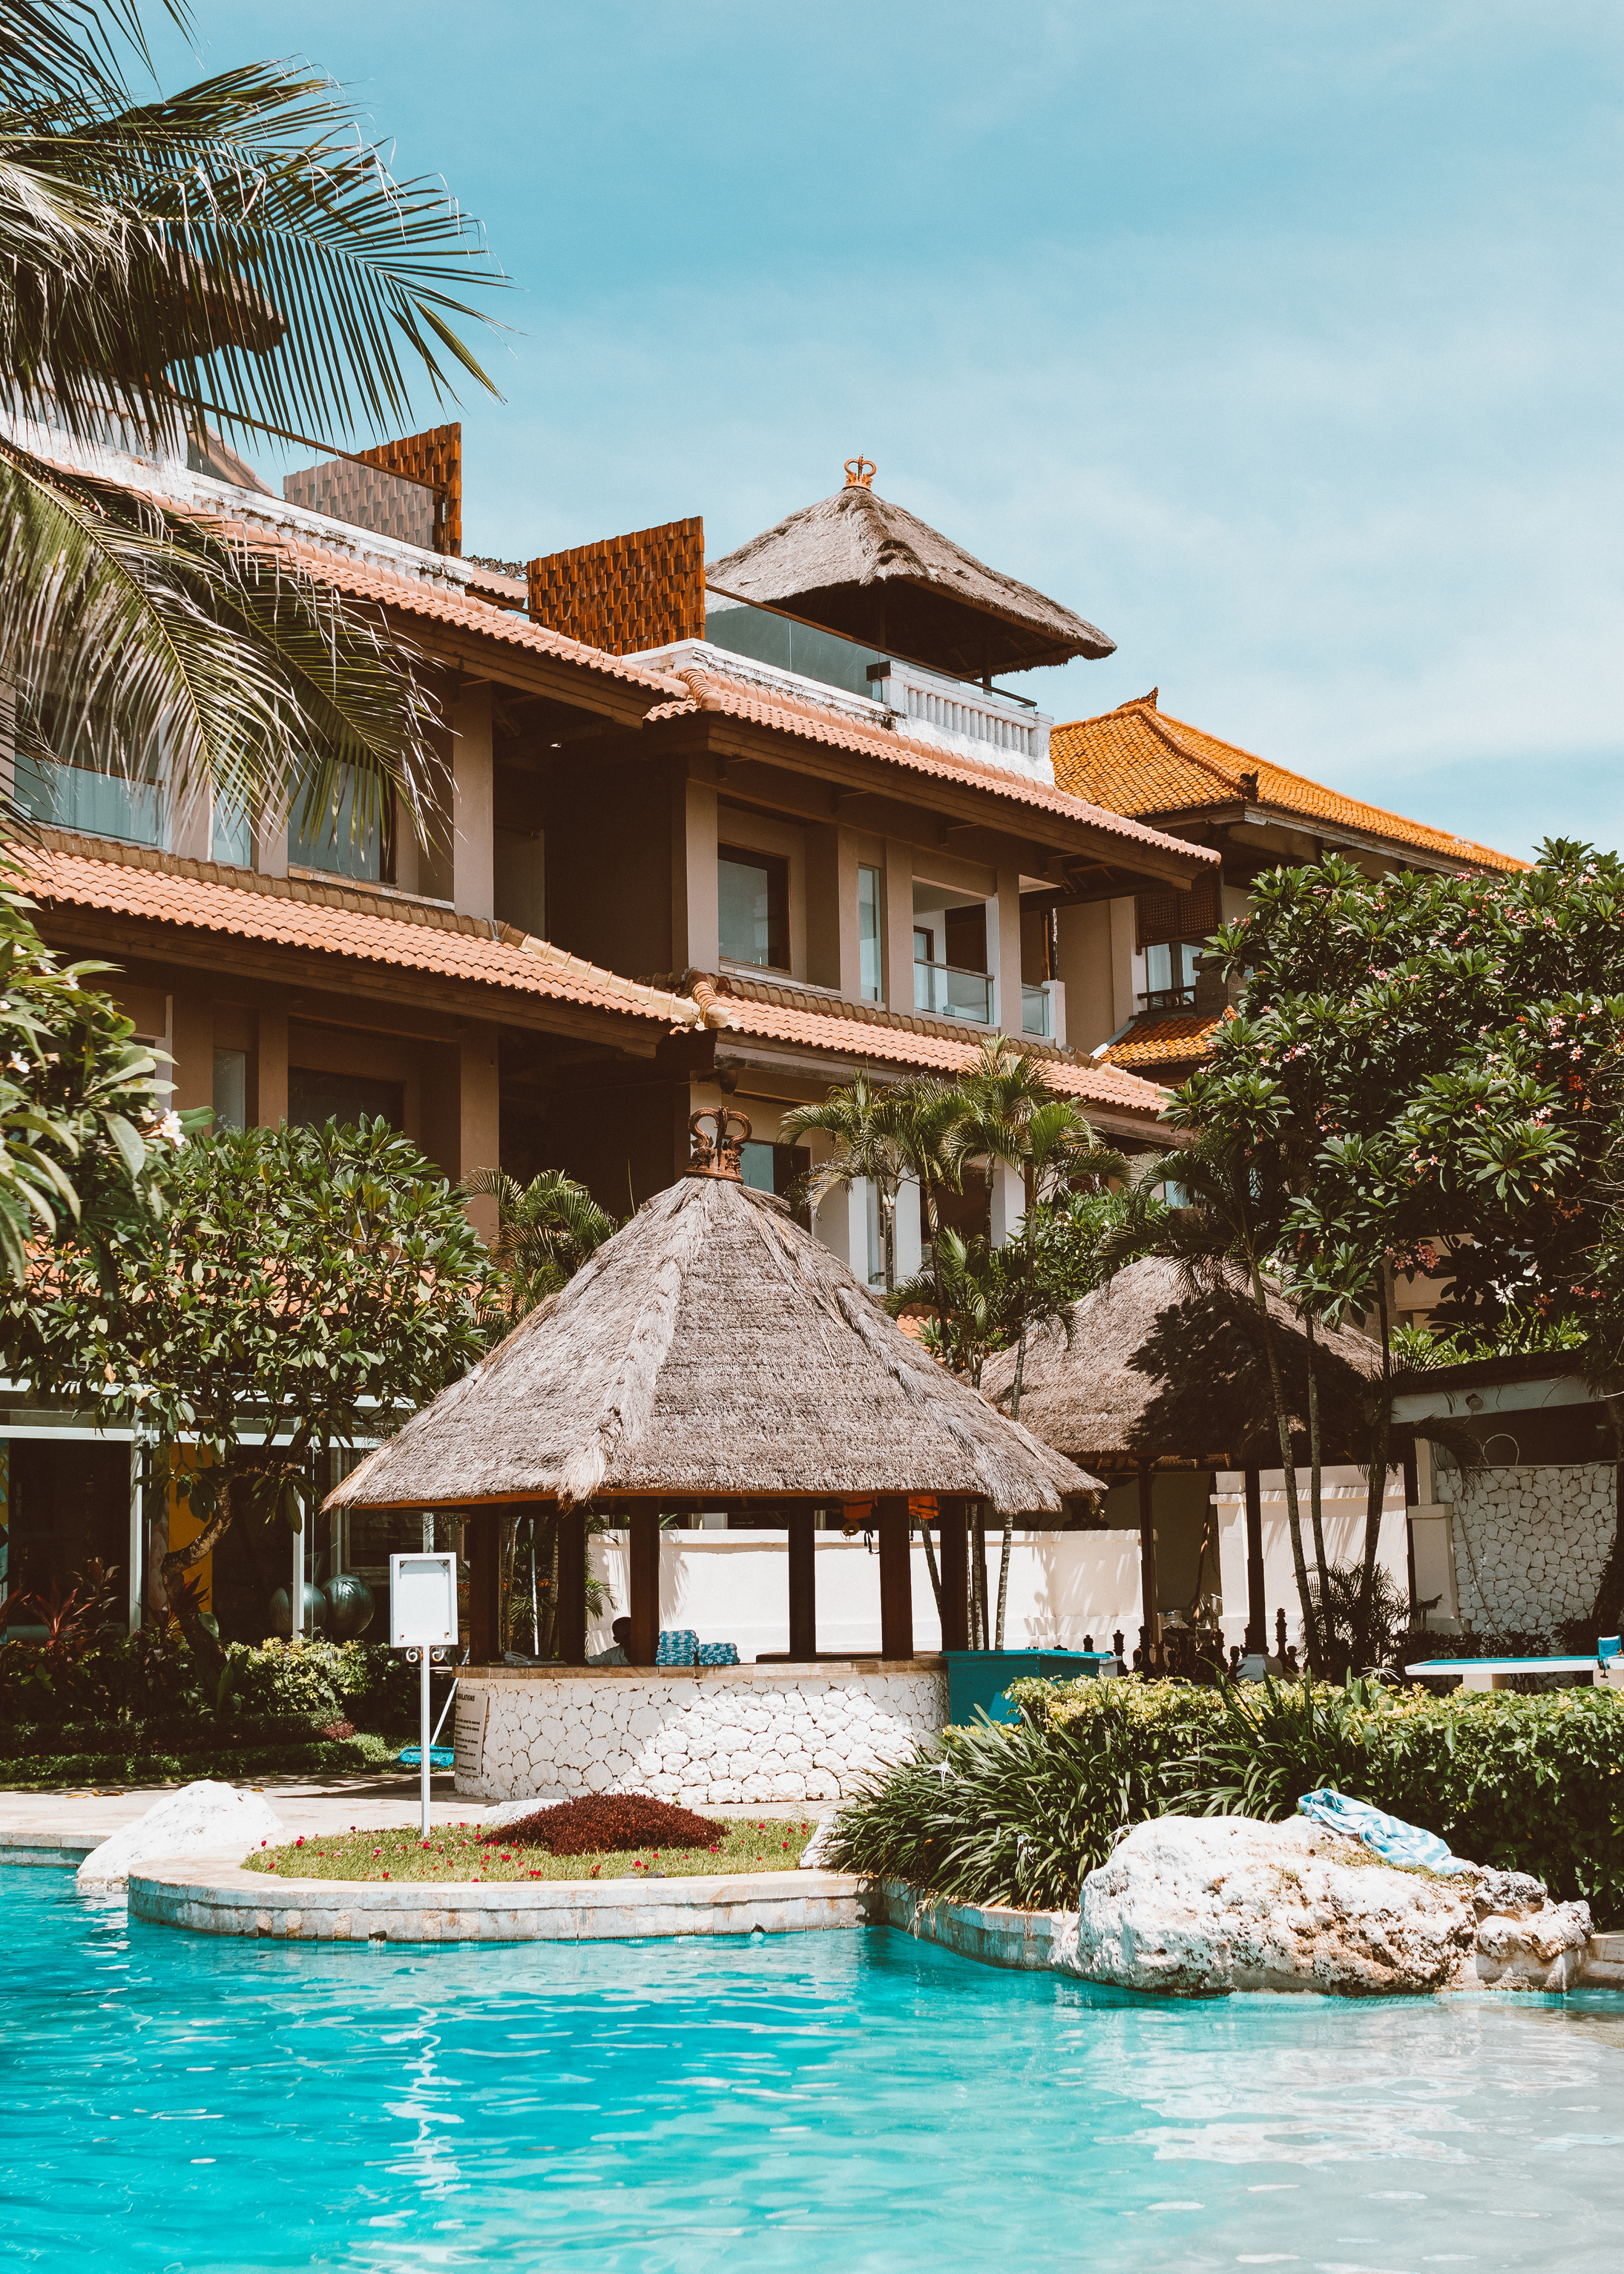
Hospitality
Analysis
AtliQ Hotels

Slide 2
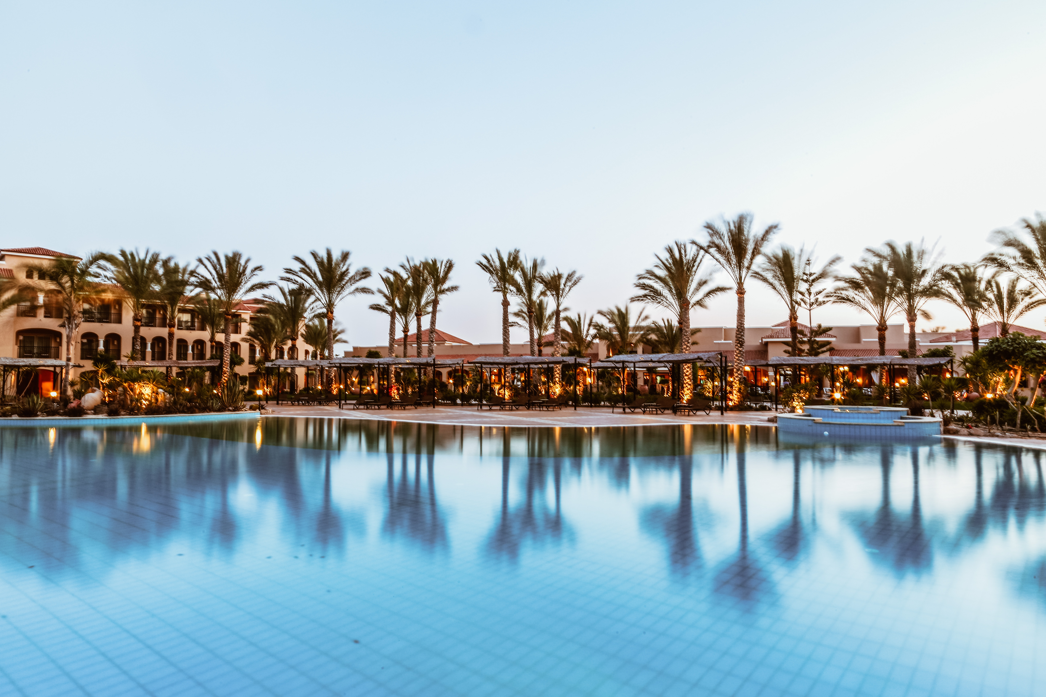
INDEX
01.
Introduction
Table
of Content
02.
Data Model
03.
Dashboard
04.
Insights & Recommendations

Slide 3
Introduction
AtliQ Grands owns multiple five-star hotels across India. They have been in the hospitality industry for the past 20 years.
Due to strategic moves from other competitors and ineffective decision-making in management, AtliQ Grands are losing its market share and revenue in the luxury/business hotels category.
As a strategic move, the managing director of AtliQ Grands wanted to incorporate “Business and Data Intelligence” to regain their market share and revenue.
TASK - Provide Insights to Revenue Management Team of AtliQ hotels by utilizing their historical data.

Slide 4
ATLIQ
Bangalore
Delhi
Hyderabad
Mumbai
Atliq Palace
Atliq Palace
Atliq Palace
Atliq Palace
Atliq Grands
Atliq Grands
Atliq Grands
Atliq Grands
Atliq City
Atliq City
Atliq City
Atliq City
Atliq Blu
Atliq Blu
Atliq Blu
Atliq Blu
Atliq Bay
Atliq Bay
Atliq Bay
Atliq Bay
Atliq Exotica
Atliq Exotica
Atliq Exotica
Atliq Seasons

Slide 5
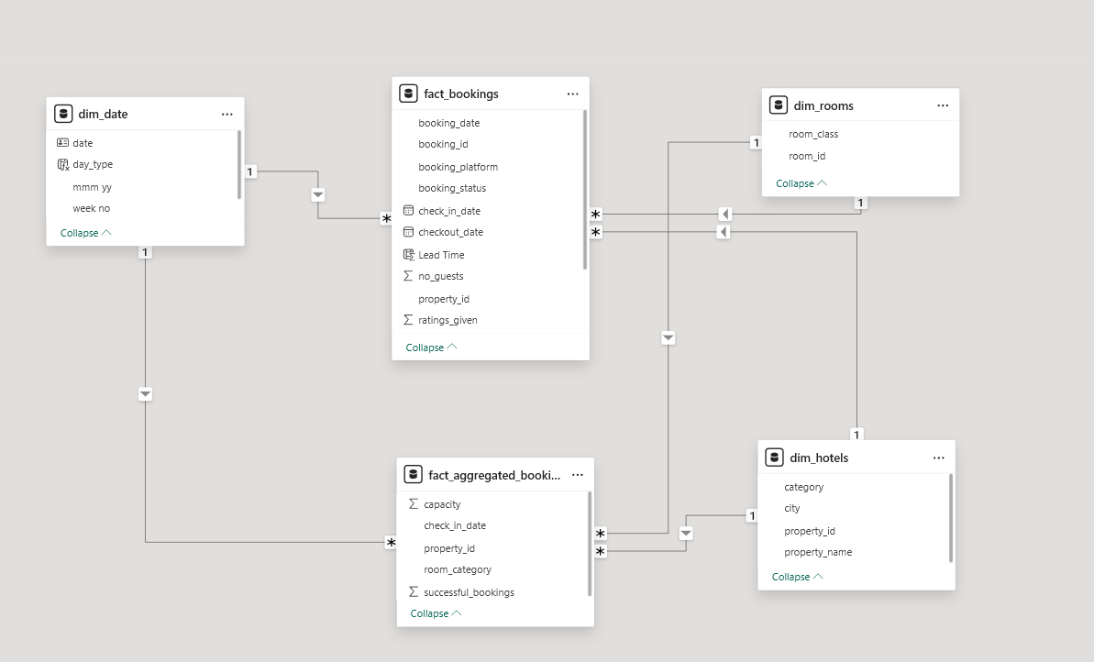
Data Model

Slide 6
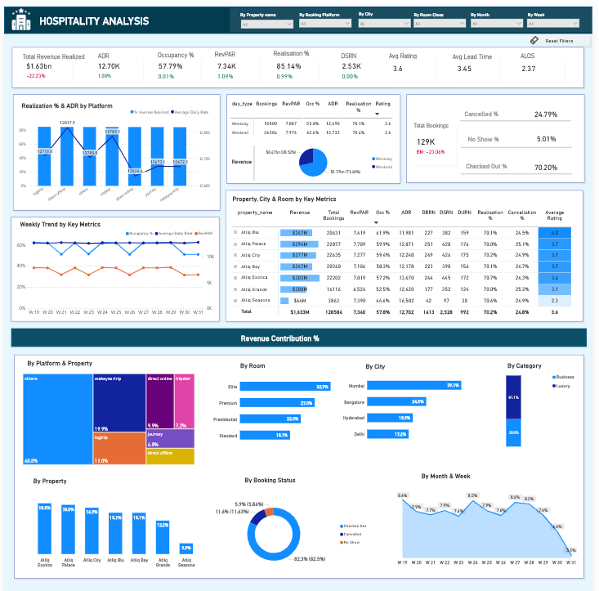
Dashboard

Slide 7
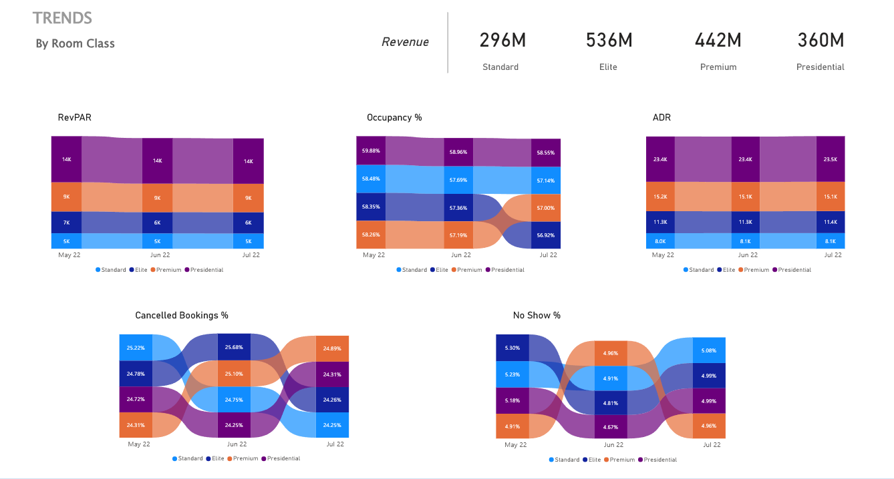
Dashboard

Slide 8
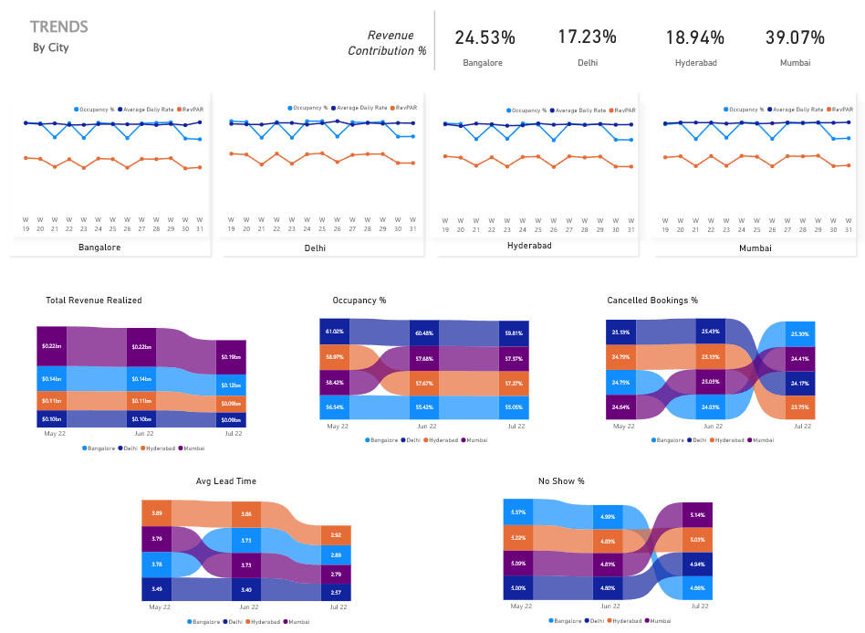
Dashboard

Slide 9



Insights & Recommendations

Slide 10
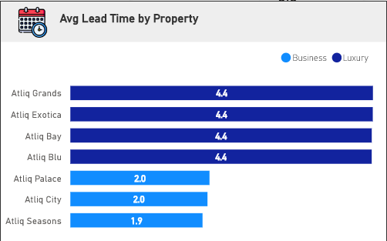



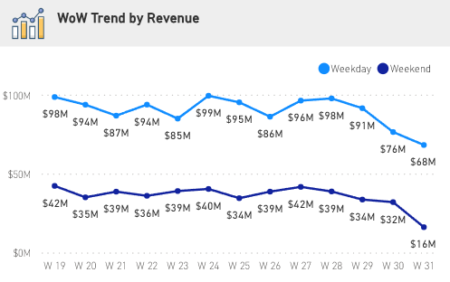
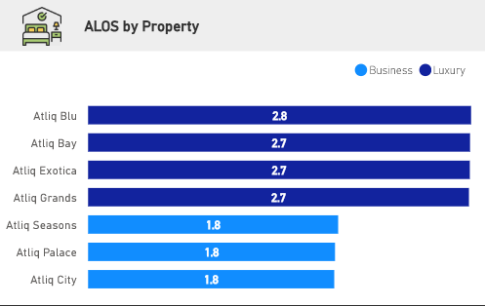
Short Lead Time and Length of Stay in Business Hotels:
Average Lead time and Average Length of stay (ALOS) is lowest for AtliQ Palace, AtliQ City & AtliQ Seasons since these three fall under Business category.
While AtliQ Palace & AtliQ city are among the top revenue generators with highest Occupancy %, AtliQ Seasons has the lowest Occupancy and generates the least amount of revenue.
Strategies for Revenue Optimization:
Streamline Check-In/Check-Out Processes
Develop relationships with corporate clients - Offer customized packages or loyalty programs to encourage repeat bookings.
Provide Business-Friendly Amenities
Offer attractive last-minute deals to fill rooms and improve guest loyalty.
Highest Revenue generated was during Week 19 ($ 140M) followed by W24 & W28.
There’s a sharp decline in revenue after W28.
In W31, weekend revenue dropped almost 50% to $16M
Implement a loyalty program that rewards repeat guests for weekend stays by offering perks such as room upgrades, exclusive discounts, or VIP experiences.
Offer personalized services that cater to weekend guests, such as complimentary breakfast, or partnering with local events or activities (e.g. concerts, festivals) to attract guests looking for weekend entertainment.

Slide 11
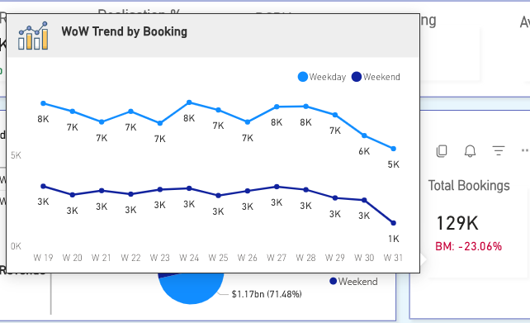
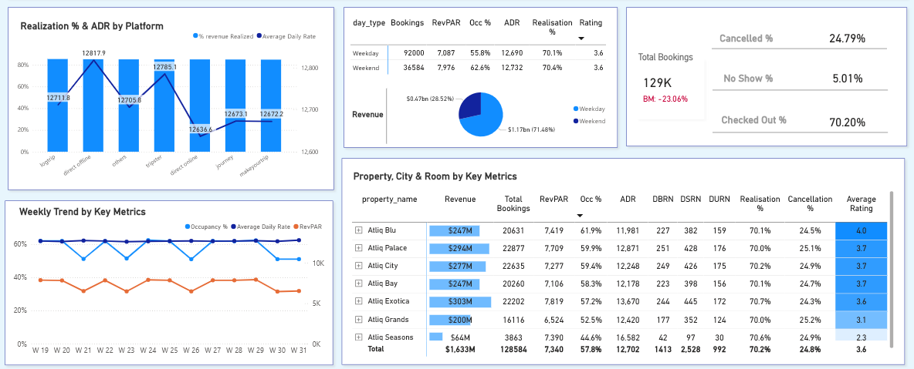
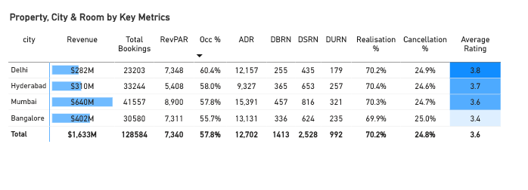
ADR for Direct Online is low compared to other Platforms but the revenue realized is almost same as other platforms.
We can use Differential Pricing here.
Direct Online Channel i.e. AtliQ’s website can offer rooms at cheaper rates to the customers as compared to other booking platforms since they do not have to pay extra platform fee. This will ensure an increase in Occupancy and hence increased revenue.
We can see a decline of (23%) in Total bookings for Week 31 as compared to previous week i.e. W 30.
On checking the trend by Weekend/Weekday, we can see a significant decline of ~85% in W31 Weekend Bookings as compared to previous weekend.
ADR is almost same on weekdays & weekends. Only Occupancy is changing which results in a change in RevPAR which tell us that weekend/weekday pricing is not used as well.
Price the Leisure hotel with weekend/weekday pricing since people travel a lot in Summers and especially on Weekends
Relation between Occupancy, ADR & RevPAR Fluctuations in RevPAR are due to Occupancy % since ADR is stable throughout the time period.
This means Flat pricing is being used by hotels.
Flat Pricing does not help us set prices based on current market trends, seasonal demands, customer preferences, etc. resulting in loss of revenue
Atliq Blu having the highest ratings has the highest occupancy while AtliQ Seasons with lowest ratings has the lowest Occupancy
Delhi having the highest ratings, tops the Occupancy ranking out of all other cities.
Bangalore has lowest rating and hence lowest Occupancy ranking compared to other cities.
Occupancy at a hotel is highly correlated with Ratings they received. This can happen when customers are not delivered what they are promised.
Improve customer experience during their stay
Make sure to update photos and details about the hotel, rooms and location on all booking platforms

Slide 12
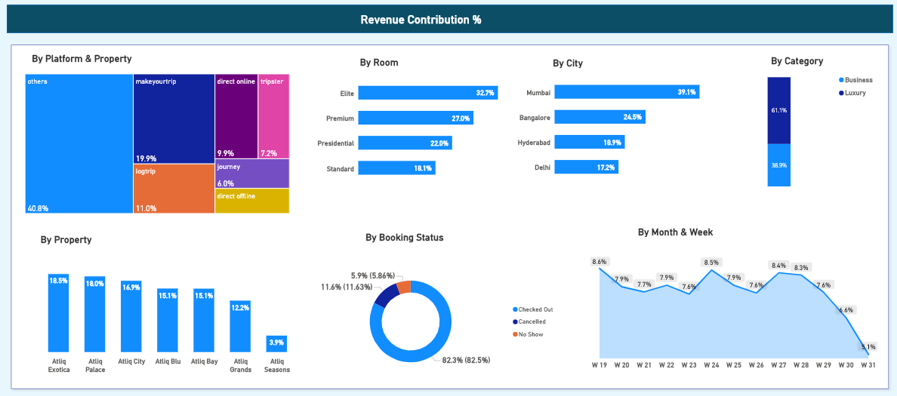
Elite rooms contribute the highest at 32.7% followed by Premium rooms at 27% and
Presidential rooms, Standard rooms at 22%, 18 %
Given that Elite and Premium rooms contribute significantly to revenue, consider investing in marketing or enhancing services for these room types to maintain or increase their occupancy rates.
Luxury hotels contribute 62% of total revenue compared to business at 38%.
Mumbai generates the highest revenue (639 M), contributing 40% of total revenue, followed by Bangalore, Hyderabad and Delhi
The largest revenue contribution in Platforms comes from the "others" category (40.8%).
Followed by Makeyourtrip and logtrip contributing 20% & 11% respectively.
Atliq Exotica (18.5%) and Atliq Palace (18.0%) are the top contributors while Atliq Seasons contributes the least at 3.9%.
Revenue shows fluctuation over the weeks with a peak at week 19 (8.6%).
There is a notable decline towards the end of the period, with week 31 showing the lowest contribution at 5.1%.
Investigate potential causes such as seasonality, market conditions, or operational issues.
Plan promotional activities or discounts to boost revenue during lower-performing weeks
The cancellation and no-show rates are notable.
Provide more flexible booking options
Offer incentives for confirmed stays.
Use Automated Reminders
Get in touch with guests when they don't turn up to learn why the guest was unable to make their reservation and use feedback from them to improve

Slide 13

More Recommendations
Unified Digital Platform:
Introduce a Hotel App and consolidate single brand websites into a unified platform.
This streamlines digital presence, enhancing operational efficiency and content management.
Unique Selling Points (USPs):
Clearly communicate USPs to differentiate hotels from competitors.
Emphasize USPs in online marketing to effectively convert potential customers.
Visual Content Strategy and Digital Asset Management:
Utilize visual assets strategically to guide customers through the purchasing process.
Customize property pages to highlight unique selling points (USPs) tailored to guest preferences like Resorts, Luxury, Business, and Airport hotels.
Automate digital asset galleries for both web and app.
Enable properties to manage visual assets efficiently, including order, addition, and removal of assets directly.
Hyper-Personalization:
Implement dynamic pricing strategies offering guests personalized promotions and discounts based on their previous booking history or as a reward for loyalty
Implement online pricing strategies like member-only rates or app-only rates since Direct Online platform (Hotel Website) contributes only 10% to revenue.
Provide real-time offers based on preferences, activity, and past bookings, leading to increased revenue and transactions.
According to a study by McKinsey, 76% of customers will buy from a brand that personalizes their marketing communications and 78% will repeat their purchase.

Slide 14
More Recommendations
According to a survey by American Express Travel, 75% of travelers say they have been inspired to travel to a specific destination by social media, while 48% want to travel to destinations that will allow them to ‘show off on social media’.
Leverage Social Media Presence by regularly sharing captivating visuals and engaging content showcasing unique amenities, experiences, and local attractions to inspire potential guests.
Create Instagrammable Spaces by designing specific areas within the hotel that are visually appealing and encourage guests to take photos.
Collaborate with local/travel influencers with significant following on social media. Invite them for complimentary stays or experiences in exchange for exposure and endorsements on their platforms, which can influence their followers' travel decisions.
To effectively manage cancellations and reduce no-shows in hotels,
Consider implementing a tiered cancellation policy that clearly communicates penalties for late cancellations or no-shows. Providing flexible booking options, such as refundable and non-refundable rates, can cater to different guest needs and reduce last-minute changes.
Utilize automated reminder emails or messages closer to the check-in date to confirm reservations and prompt guests to communicate any changes early, helping to minimize lost revenue from empty rooms and optimize occupancy rates.
Trend – WORKCATION (vacation with remote work):
Create work-friendly spaces, offering business-oriented services, and promoting workcation packages by offering on-site activities and partnering with local businesses for curated guest experiences.
Sustainability Initiatives:
Implement eco-friendly practices such as solar panels, smart thermostats, and comprehensive recycling programs.
Launch sustainability programs to showcase sustainability efforts to guests and offer them to participate as well. This is turn boosts Brand image, attracts Eco-conscious travelers and helps in cost savings as well.

Slide 15
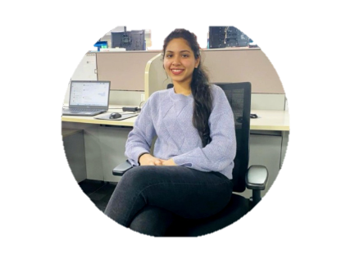


Thank You !
@kanikamittal086
@Kanikamittal99

